Slide 1


Titolo presentazione sottotitolo
SafeStreets
Andrea Falanti (944954) Andrea Huang (866900)
Milano, XX mese 20XX
Professor: Elisabetta Di Nitto

Slide 2
Introduction
2
Citizen
Send report
Analyze data
System
Validate report
Generate interventions
Authority
Municipality
Analyze data
Analyze data
Andrea Falanti, Andrea Huang

Slide 3
Main goals
3
Allow users to send a report of a possible traffic violation, identifying clearly the transgressor.
Allow municipalities to generate a list of possible reasonable interventions to resolve the violations detected in most unsafe areas.
Report certified traffic violations to authorities of city where the violations have happened.
Provide a synthesis of all the violations' data to users, based on their authorization level.
Andrea Falanti, Andrea Huang

Slide 4
Main goal 1
4
G6. Allow users to send a report of a possible traffic violation, identifying clearly the transgressor.
R8. The system must receive correctly the reports about the various traffic violations from the users, discarding reports with incomplete data.
R9. The system must be able to recognize the license plate of the vehicle involved in the violation from the first photo of the report.
D6. The GPS sensor of a user’s device has an error of at most 5m from the real position.
D7. The internet connection is always available when the user interacts with the system.
D10. License plates are unique.
D11. The first photo taken by a citizen reporting a violation must clearly show the license plate of the involved vehicle.
D12. The OCR service is always available.
Andrea Falanti, Andrea Huang

Slide 5
Main goal 2
5
G3. Allow municipalities to generate a list of possible reasonable interventions to resolve the violations detected in most unsafe areas.
R2. Reports about traffic violations need to be stored in a database, also associating them to the user profile who sent them.
R4. The system must be able to generate a list of possible interventions when a municipality requires it for evaluation, based on stored reports.
D3. Municipality service about accidents is always available, when pro- vided.
D4. Municipality accidents’ data is always accurate.
Andrea Falanti, Andrea Huang

Slide 6
Main goal 3
6
G1. Report certified traffic violations to authorities of city where the violations have happened.
R1. When a traffic violation is reported, the system must allow the
authorities of the city where the violation happened to verify it.
R8. The system must receive correctly the reports about the various traffic violations from the users, discarding reports with incomplete data.
D2. Users report violations when they detect them.
D5. Authorities must validate or invalidate reports after they have super-
vised them.
D8. Every city has authority institutions.
Andrea Falanti, Andrea Huang

Slide 7
Main goal 4
7
G5. Provide a synthesis of all the violations’ data to users, based on their authorization level.
R5. Traffic violations data must be available for public consultation with different levels of visibility, according to user’s level of authorization.
D5. Authorities must validate or invalidate reports after they have supervised them.
D7. The internet connection is always available when the user interacts with the system.
D13. The maps service is always available.
Andrea Falanti, Andrea Huang

Slide 8
Alloy analysis (Asserts)
8
a report supervisor can also visualize the report
authority users can access only reports from their city
authority users of same organization visualize same reports
municipality users of same organization visualize same interventions
Andrea Falanti, Andrea Huang

Slide 9
Alloy analysis (worlds)
9
Only validated reports that satisfy the filters of a data request are associated to it.
Check that a data request can be associated to an empty report list.
Check that interventions situated in a city are accessible only by that city’s municipality.
Check that reports situated in a city are accessible only by that city’s autorities.
Andrea Falanti, Andrea Huang

Slide 10
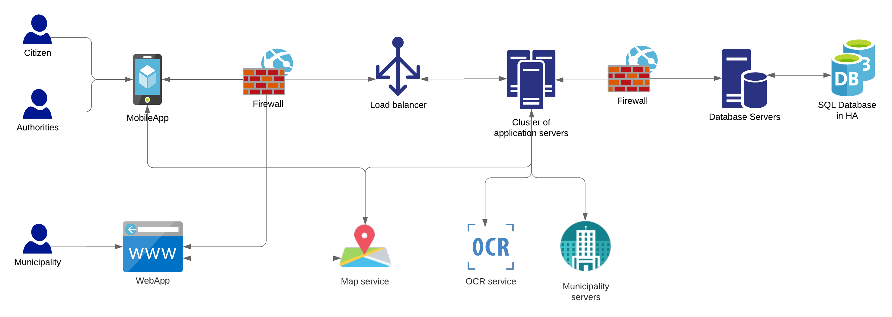
System architecture
10
Based on 3 tier architecture
Andrea Falanti, Andrea Huang

Slide 11
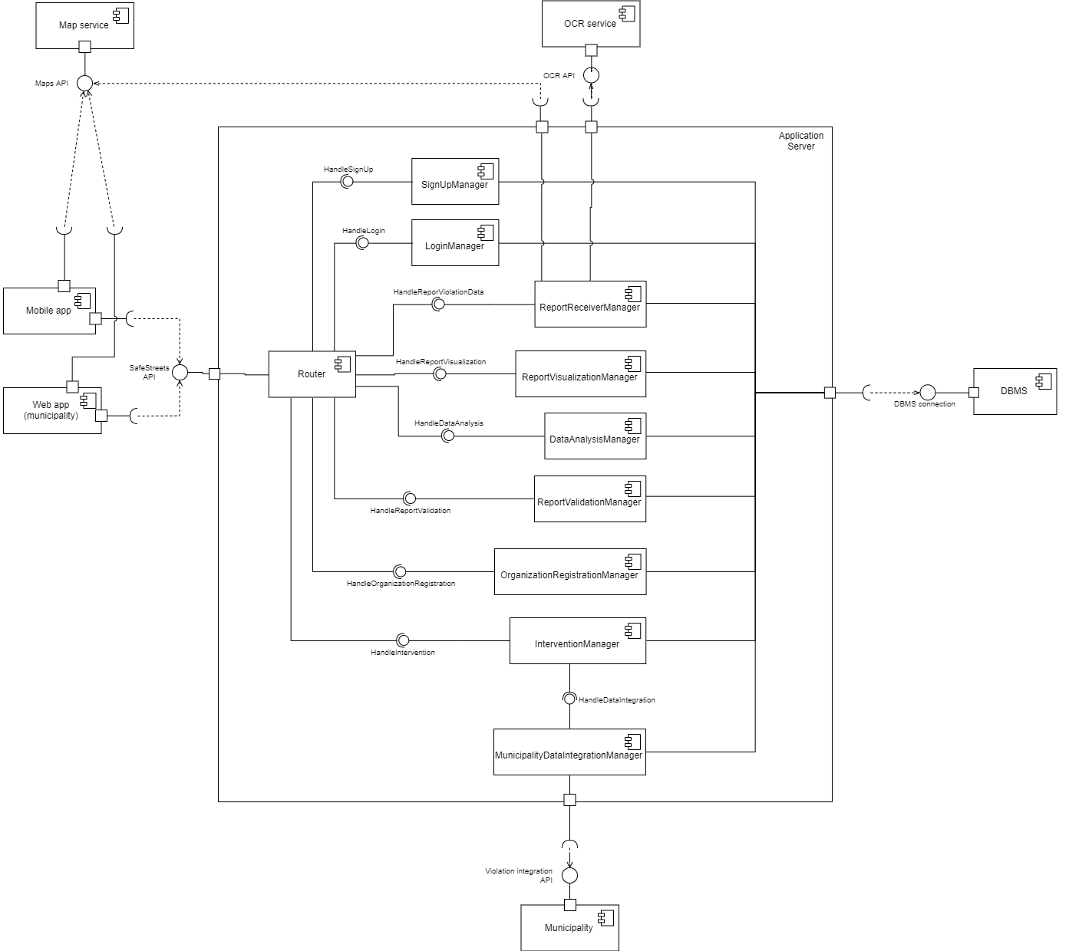
Component view
Component view
11

Slide 12
Component descriptions
12
Router: receives requests, calls right manager for request, sends responses.
SignUpManager: handles sign up requests, automatically recognizes email domains associated to organizations.
OrganizationRegistrationManager: handles registration of organizations (authorities and municipalities), registration is done by SafeStreets operators.
LoginManager: handles login requests.
ReportReceiverManager: handles automatic plate recognition from first photo taken, handles reverse geocoding of report position, meta data completion and stores valid reports in DB.
Andrea Falanti, Andrea Huang

Slide 13
Component descriptions 2
13
ReportVisualizationManager: provides reports accessible to the account that made the request.
ReportValidationManager: allows authorities to change report status.
DataAnalysisManager: handles data requests for all kinds of account, providing different data based on account permissions.
InterventionManager: handles interventions generation, calls data integration before running the algorithm.
MunicipalityDataIntegrationManager: allows the system to interact with a municipality’s API to download most recent data and integrate it into the system database.
Andrea Falanti, Andrea Huang

Slide 14
Implementation - introduction
14
System prototype consists of:
Server
Client
Prototype doesn’t implement these functionalities:
Email confirmation on sign up
Functionalities related to municipalities
Lacks proper deployment, actually runs locally
Andrea Falanti, Andrea Huang

Slide 15
Server
15
Runs in Node.js environment
Scalable and customizable, thanks to the various NPM packages
Fast performances granted by its asynchronous nature (avoids thread overhead)
Compliant with OpenAPI 3 specifications
Andrea Falanti, Andrea Huang

Slide 16
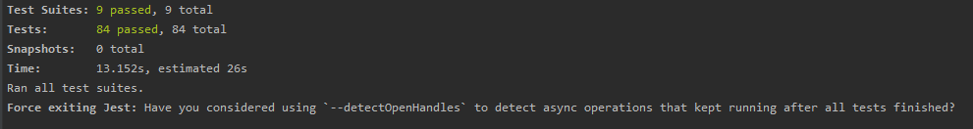
Server - Testing
16
Server code is fully tested, using Jest, SuperTest and Puppeter packages.
Unit tests: focused mainly on database queries and operations results.
Integration tests: simulate API requests and check that the correct response/error is returned.
End-to-end tests: tests SafeStreets operators web interface, running interations on a headless browser.
Post analysis with SonarQube, checking the quality of code developed.
Andrea Falanti, Andrea Huang

Slide 17
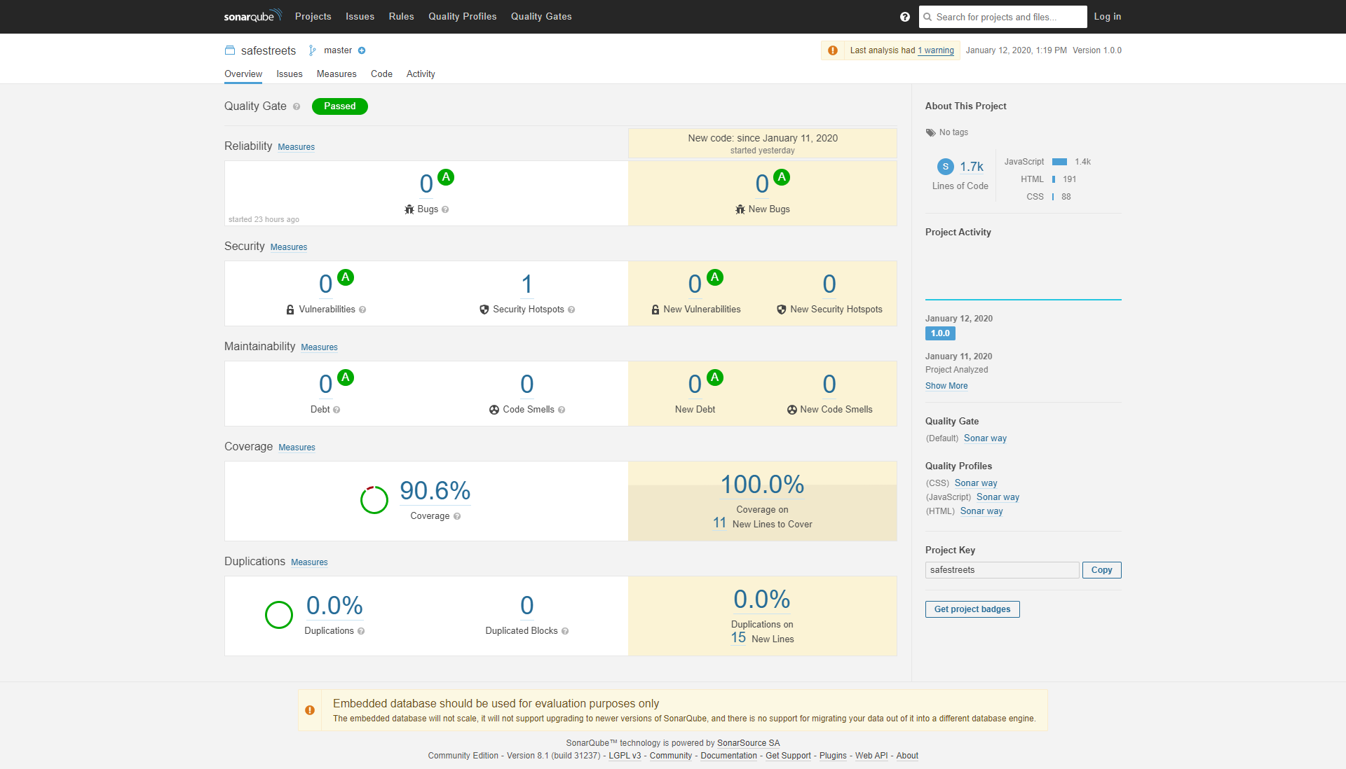
Server – Code Quality
17
Andrea Falanti, Andrea Huang

Slide 18
Client
18
Developed using Flutter framework
Allows fast development, using one codebase for both Android and iOS devices.
Easy and fast debugging thanks to ‘‘stateful hot reload’’ feature
Great library of packages, handled by Pub package manager
Andrea Falanti, Andrea Huang

Slide 19
Client - structure
19
Each screen uses an MVP pattern to separate the view from the communication and business logic.
Unit tests on business logic of the application, in particular data manipulation.
Andrea Falanti, Andrea Huang

Slide 20
Conclusion
20
Thanks for your time!
Contacts:
andrea.falanti@mail.polimi.it
andrea.huang@mail.polimi.it
Andrea Falanti, Andrea Huang

